Slide 1
A New Annotated Summarization Corpus
Wencan Luo
05/28/2015

Slide 2
Summarization with student coverage
Student Coverage (i.e. how many students semantically mention a point in the summary)
Prompt: Describe what was confusing or needed more detail
1) Graphs of attraction/ repulsive & atomic separation [10]
2) Properties and equations with bond strength [7]
3) Coefficient of thermal expansion [6]
4) Activity part III [4]
10 out of 53 students had problems understanding the two types of graphs;
another 7 students were confused about the properties and equations with bond strength;
6 students need more explanation of thermal expansion coefficients...

Slide 3
Hard to evaluate the summary
Abstractive Human Summary
Extractive System Summary
1) Graphs of attraction/ repulsive & atomic separation [10]
2) Properties and equations with bond strength [7]
3) Coefficient of thermal expansion [6]
4) Activity part III [4]
1) the class [17]
2) equations with bond strength and hooke ’s law [10]
3) graphs and equations [8]
4) graphs of attractive + repulsive forces [6]
Where is the summary from?

Slide 4
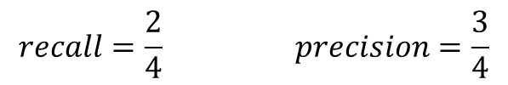
Hard to evaluate the summary
Abstractive Human Summary
Extractive System Summary
1) Graphs of attraction/ repulsive & atomic separation [10]
2) Properties and equations with bond strength [7]
3) Coefficient of thermal expansion [6]
4) Activity part III [4]
1) the class [17]
2) equations with bond strength and hooke ’s law [10]
3) graphs and equations [8]
4) graphs of attractive + repulsive forces [6]
$$recall=\frac{2}{4} precision=\frac{3}{4}$$

Slide 5
A new corpus collected by CourseMIRROR
Spring 2015, Statistics for Industrial Engineers
Boğaziçi University (Turkey)
68 students signed up for the user study
22 lectures are open for reflection submission
Ave number of lectures submitted by per student : 12.8
2 reflection prompts
POI: Describe what you found most interesting in today's class?
MP: Describe what was confusing or needed more detail?

Slide 6
Summarization annotation
Two annotators (graduate students at Pitt)
One major in Math
The other majoring in Statistics
Native English speakers
Summaries are created after each lecture
22 lectures
$25 per lecture, per annotator
Tasks (see example)
Phrase Summarization
Half have phrase annotation
Half not
Abstract Summarization
Extractive Summarization

Slide 7
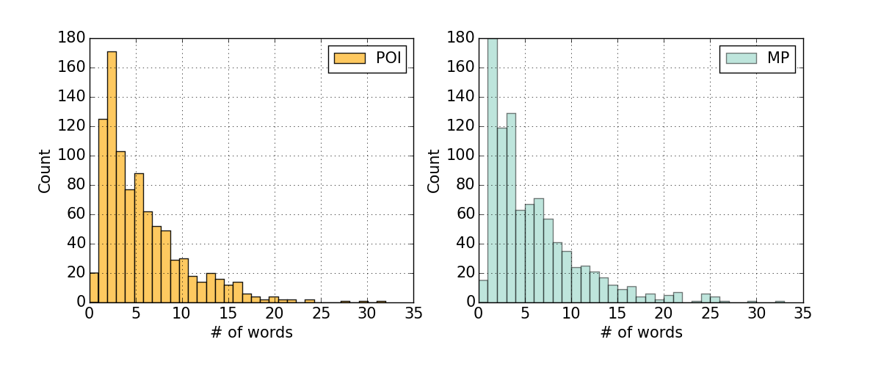
Basic statistics: students‘ response
 | # of sentences | # of words | average length
POI | 925 | 4,983 | 5.4
MP | 934 | 5,143 | 5.5

Slide 8
Basic statistics: summaries
Average Length | Phrase | Abstract | Extractive
Annotator 1 | 14* | 29* | 29
Annotator 2 | 15 | 36 | 32
* means: summaries given by annotator 1 is significantly shorter than annotator 2, p <0.05

Slide 9
Summary preference: Individually
Preference | Phrase | Abstract | Extractive
Annotator 1 | 0 | 15 | 2
Annotator 2 | 4 | 4 | 9
Change the mind?
No!
Preference | Phrase | Abstract | Extractive
Annotator 1 | 0 | 15 | 2
Annotator 2 | 3 | 5 | 9

Slide 10
Exploratory questions
How long does it take to create a summary?
reading the responses is time-consuming
creating the abstract and extractive summaries takes about only 1 min
Does annotating the phrases make the summary quality better?
summary with phrase annotation vs. without
how to measure the agreement?
How to evaluate the numbers?
two gold standard
partial overlap due to the phrase extraction
More?

